Slide 1
Predictive Analytics
Which iPad listing will be sold on eBay?
Class Project: MITx Analytics Edge 15.071x
By Sarah Huang

Slide 2
Overview
The project challenges students to develop an analytics model that will help buyers and sellers to predict the sales success of a set of eBay listings for Apple iPads from spring 2015.
The competition is hosted on the Kaggle platform.
The independent variables consist of 9 pieces of product data available at the time the iPad listing is posted, and a unique identifier.
The training set consists of 1,861 observations and the testing set consists of 798 observations.
The goal is to predict if a listing will be sold or not.
The code is written in R and is available on my GitHub.

Slide 3
Data Fields
The provided features includes the following:
Text description
Biddable (boolean)
Start price of auction if biddable, or the asking sales price if non-biddable
Condition of the product
Cellular (boolean). If the product is available to be connect to a cellular network
Carrier
Color
Storage
Product line

Slide 4
Modeling Approach
The number one determinant of whether a product will be sold or not is price.
The biddable items usually have start price that is far lower than the reasonable market price.
One of the major features will be to compare the start price against a reasonable market price of the product. The assumption is that start price lower than the reasonable market price will be sold, while start price higher than reasonable market price will not be sold.
To determine the reasonable market price, a smaller set of training set is created by filtering out observations that are non-biddable and are sold.
An ensemble of glm (generalized linear model), random forest, gbm (generalized boosted model), and deep learning models are used to predict the reasonable market price of all observations using the above filtered set as training set. The dependent variable is the start price.
The predicted price is used to create three features

Slide 5
Feature Engineering based on predicted price
feature 1:
Take the difference between the predicted price and the start price
feature 2:
Compute average predicted price based on grouping of product line and product condition
Take the difference between the above average predicted price and the start price
feature 3:
Compute average predicted price based on grouping of product line, product condition, and storage.
Take the difference between the above average predicted price and the start price

Slide 6
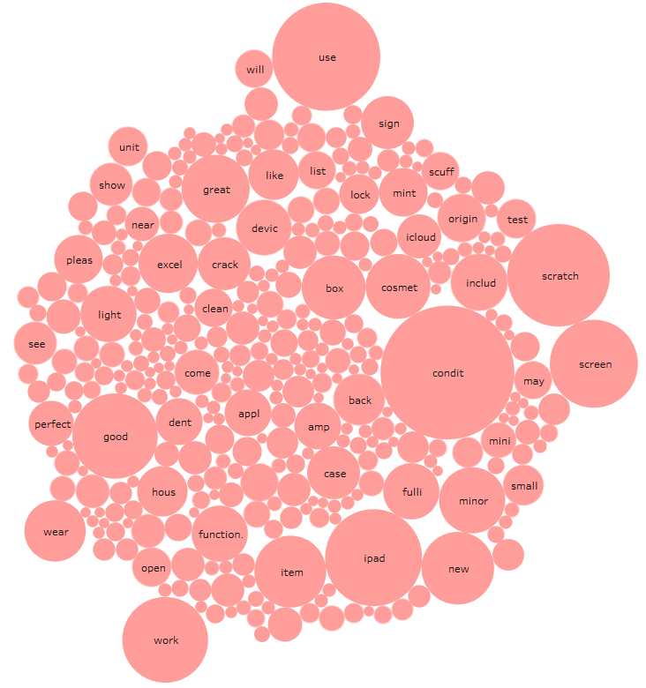
Text Analytics
The description field is converted to word vectors
The data is preprocessed – stemming, remove numbers, remove punctuation, remove stop words, convert to lower case, etc.
Sparse terms are removed with 0.999 threshold
The resulting term-matrix has about 350 words
A new feature that counts the number of terms for each observation is added

Slide 7
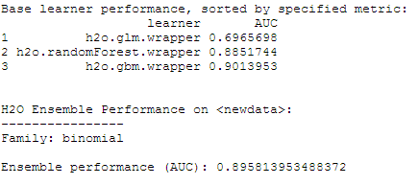
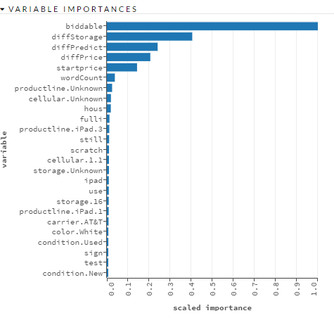
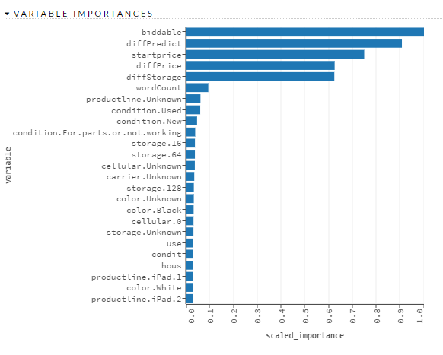
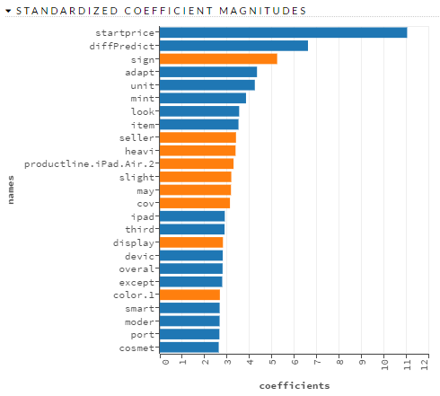
Model Performance
An ensemble of models is used to predict if a product will be sold or not
The most important features are whether a product is biddable or not, and the price related features
GBM
Random Forest
GLM

Slide 8
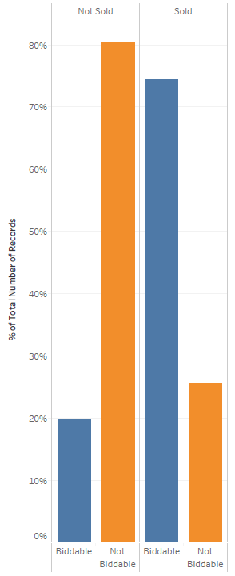
Biddable products are more sellable
Biddable products accounts for 74% of all sold products
80% of unsold products are non-biddable

Slide 9
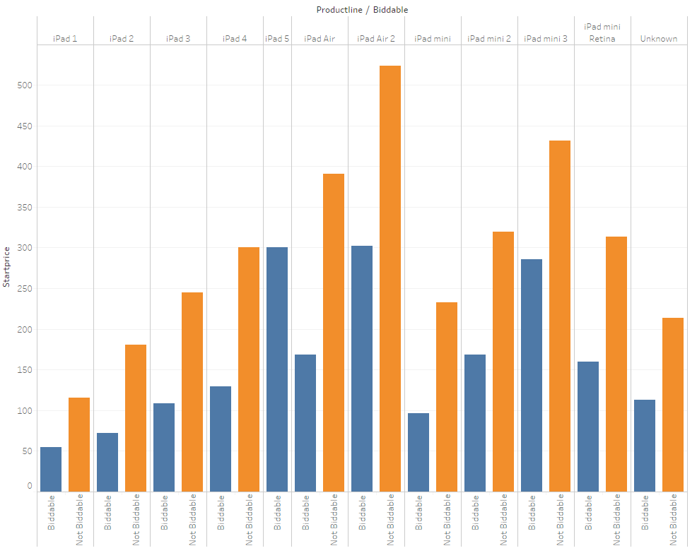
Biddable start prices are in general lower than non-biddable prices

Slide 10
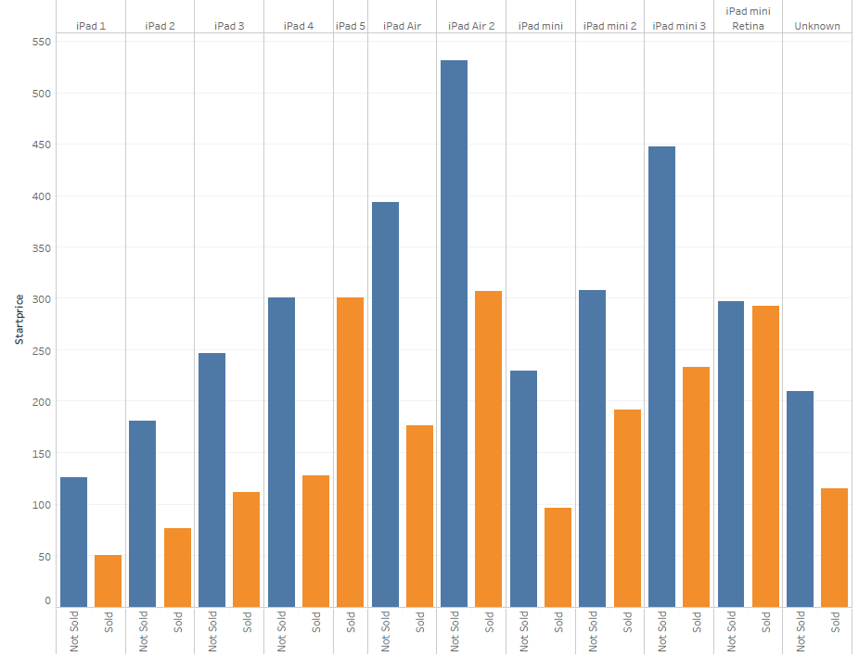
Price is the primary determinant of whether a listing will be sold or not. The average start price of sold items are lower than unsold items.

Slide 11
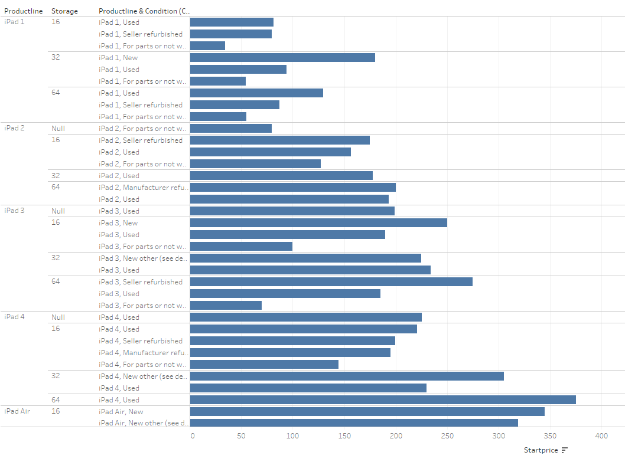
Average price varies depending on product line and condition of products

Slide 12
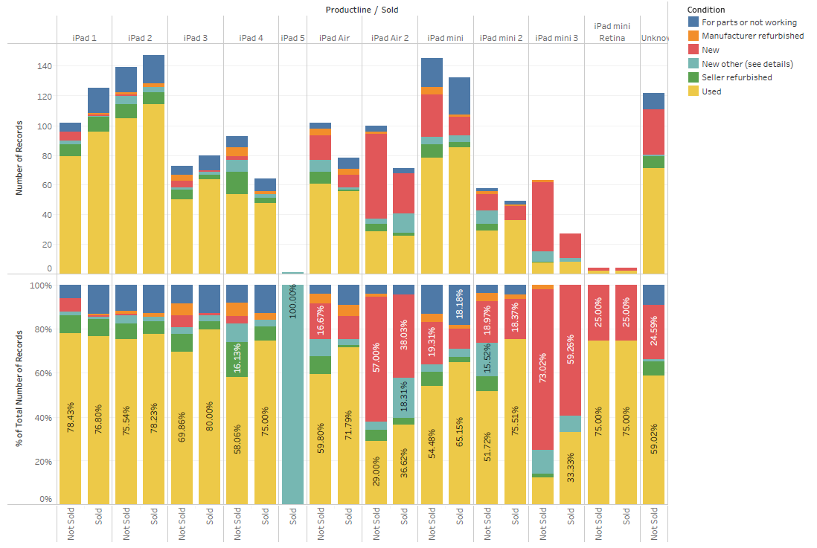
However, product condition itself does not determine if a product will be sold or not.
% of sold and unsold products are similar regardless of product conditions.

Slide 13
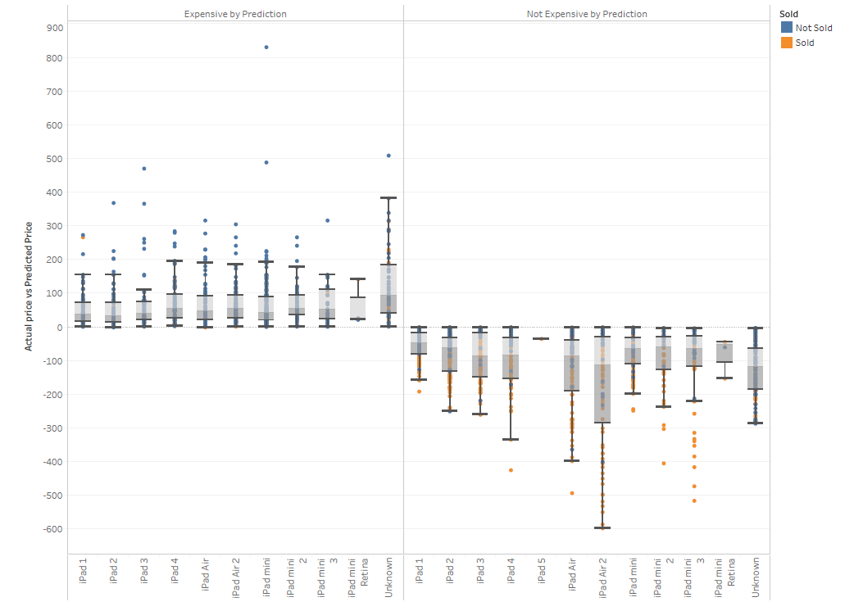
Price is the key Products that are deemed expensive based on predicted value are mostly not sold (in blue), and products deemed cheap by prediction are mostly sold (in orange).

